Slide 1

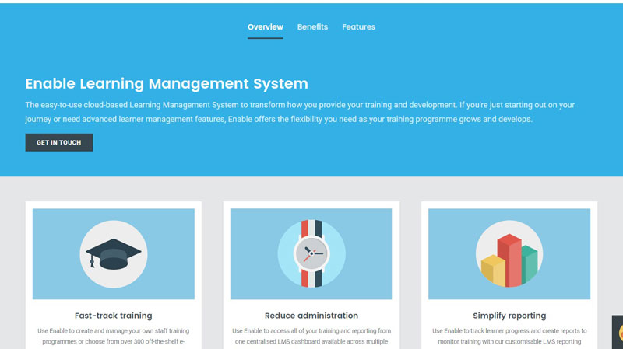


Project Planning: Task 1
Develop and Design an online music learning management system (LMS) that uses learning analytics and Gamification technique to increase student success.
Notes:
University of Hertfordshire
School of Computer Science
CTS College of Business & Computer Science.
BSc Information Technology
Student ID: 18050879
Module: Project Planning
Level: 6
Academic Year: 2019-20

Slide 2




LMS and The Music Education Industry
Background: The growth of the music industry has led to more music stores selling musical instruments as well as schools and private tutors offering music education as well as websites offering online learning.
Problem: These programs suffer from high attrition rates whereby users struggle with commitment, procrastination due to time management and lack of website content literacy, lack of formal feedback leaving them prone to the development of bad technical and practice habits.
Solution: This project proposes to increase the success rate in the music industry by designing and developing an online music learning management system that uses learning analytics and machine learning to increase the completion rate while focusing on user experience and design aesthetics to ensure that the system is user-friendly.
Notes:
The music industry is an ever-evolving, billion-dollar industry (Gheorghe, 2015). There are more music stores selling musical instruments as well as schools and private tutors offering music education. Online services such as GuitarHero and Rocksmith use game-based learning to improve learning in the music industry (Robertson, 2012). Additionally, websites such as truefire.com and fretjam.com deliver blended learning to improve education. According to Forbes (2019), while there is a steady increase in enrolment in online music programs, there is also a high attrition rate. This is as a result of some demographic variables such as users’ age, marital status and employment. Additionally, users struggle with commitment, procrastination due to time management and lack of website content literacy, lack of formal feedback leaving them prone to the development of bad technical and practice habits. This project proposes to increase the success rate in the music industry by designing and developing an online music learning management system that uses learning analytics and machine learning to increase the completion rate while focusing on user experience and design aesthetics to ensure that the system is user-friendly. Game-based learning is used to help students build and seek informal feedback to better playing habits. Blended learning along with gamification strategies will be used to keep students involved and to increase learning motivation. Depending on the availability of codes and feasibility, sound analysis Library will be explored to allow students to play games with their musical instruments, as this can help students in their rhythm and allow for tuning of musical instruments like their guitars.
[Words: xxx]

Slide 3
Analysis of LMS functional requirements
Learning Analytics
Gamification
Game-Based Learning
Collaboration
Responsive Design
Simple Dashboard
Notes:
Learning Analytics: The information accumulated is used to help create an accurate understanding of the needs of regular users Also to monitor significant relationships with academic achievement and display analyzed results and make recommendations for success, to maximize user abilities and minimize attrition.
Gamification: Students collect points, prizes and scores for completed assignments that unlock levels or units. This strategy allows learners to engage more actively in education and practical exercises, decreasing retention and increasing motivation.
Game-based learning: Using video games, quizzes or instrument rhythm games additional feature; users can play using their computer or mobile microphone to capture sound frequencies from a musical instrument to play live feedback learning games, metronome or educational game, to help with their rhythm and raise the level of confidence.
Collaboration: Includes forums or blogs which empower users to share ideas and knowledge and to engage social learning. The program uses a social networking site to facilitate communication between regular users by using a discussion forum.
Responsive Design: Enables user experience on multiple devices, creating a responsive website that makes web pages render well on a variety of devices. Students can play their musical instruments using mobile devices to reduce straining and increase mobility. Also providing easy-to-read instructions and formats to function on any device.
Simple Dashboard: This functionality allows users to monitor warnings, schedules, analysis reports and reminders using bar graphs, maps of user analysis, etc. Arranging everything on a single dashboard, to make searching for resources easier and enable better learning management.
Words(250)

Slide 4
Reviewed Objectives
Background Research –brief research carried out on LMS.
1
Requirements Analysis – The Review of specifications for a successful LMS
2
Design – Review of the LMS model and structure.
3
Implementation – the development of the LMS
4
Testing – System is tested to ensure proper working functions.
5
Evaluation – system reviewed to ensure it is in line with expectations
6
Final Report - Document experience and goals that have been successful or unsuccessful
7
Notes:
Complete requirements analysis which lists the functional and non-functional requirements for the LMS which will be used to design, develop and evaluate the completed system, by 18 November 2019.
Use secondary information from published books and articles to conduct background research on sound recognition online and other technical features to understand how it works in a learning management system and create a Gantt diagram to prepare the project by 6 January 2020.
Design the front end with all the functionalities using a low-fidelity model with an ERD sketch including the use of back-end database tables to ensure that the application will fulfill all the requirements by 20 January 2020
Implement a front end of the learning management system by assessing open source software and integrating existing codes and advance functionality in ASP.NET to ensure that the system is tailored to music learning by 28 March 2020.
Test the online system by performing supervised tests and ensure that the system is thoroughly tested based on online standards to ensure that the application works as intended by 4 April 2020.
Using heuristic analysis to evaluate the application's functionality to assess how well the system operates, by 14 April 2020.
Complete the writing of the final report along with all the appendices to document the work done in the project to satisfy the module assessments, by 25 April 2020
[Words: xxx]

Slide 5
Literature Review of LMS Methodology
Literature review- research scope
Software Development Lifecycle (SDLC) – Planning strategies available
Rapid Application Development (RAD) Methodology –plan method for project
Notes:
The literature review of this paper will focus on secondary research using already published materials and peer-reviewed materials for learning management systems’ features and functionality. A quick review of existing learning management systems downfalls and successes. Further research will be conducted via books, articles and trusted sources on the use of learning analytics which will assist in identifying how users interact with course content, learning activities and with each other. This will help in developing an accurate understanding of users’ needs which can be used to enhance the LMS. Additionally, research will be done on gamification and game-based learning with blended learning to enhance the user experience and boost learning. Software Development Life Cycle (SDLC) framework will be used to structure this project. The Waterfall, Spiral, and Rapid Applications Development (RAD) methodologies’ strengths and weaknesses were reviewed to choose the best for this project. The RAD was considered the most suitable for this LMS due to time constraints and lower risks, it is flexible and adaptable to changes as it incorporates short development cycles (Mishra, 2013). A literature review paper will be reviewed later to identify and document the relationship between the last phases of the project and initial research.
Words(200)

Slide 6
Learning Management System issues
This LMS ensures private information is secure and computer misuse acts are not violated. primary research may be conducted later.
Legal
keeping all data protection laws, addressing copyright and content privacy
Social
LMS does primary research authorization, data protection, user consent and identity are considered
Ethical
products content will be created for this LMS and software used for development are produced from legitimate sources.
Professional
Notes:
This LMS may include primary information-gathering, following the criteria of the UH-Ethics-Approval-Utilizing-Structure-EC1A to conduct primary. No unauthorized or compromised software will be used, open-source, free or monthly trials to prevent infringing Computer Misuse Act 1990.
The Safeguarding Vulnerable Group Act 2006 and the Disclosure and Barring Service (DBS) will not be necessary. Known measures will be put in place to protect users’ data and comply with all laws including GDPR and Data Protection Act, 2109.
This LMS is not indented to go beyond this Project module, hence there should not be any violation of Data Management Policy (IM16) or Copyright, Designs and Patents Act 1988.
Videos, pictures and games will be created for this LMS and the software's being used to produce the LMS are legitimate from Microsoft Library in the UH library. As this is an academic project the choice of language, abbreviations, content, layout, and customs are considered.
Words(150)

Slide 7
Students Project Critique
Project Objective: “Design, develop and evaluate an online learning management system for the improvement of adult literacy that uses gamification techniques and learning analytics to enhance the user experience”
Critique: to focus more on usability and considering users level of literacy.
Name: Barry Moniquette
School: CTS College of Business and Computer Science Ltd
Year: 2019
Notes:
This is a critique of the following objective “Design, develop and evaluate an online learning management (LMS) system for the improvement of adult literacy that uses gamification techniques and learning analytics to enhance the user experience” by Barry Moniquette. LMS illustrates two complex functionalities; gamification and learning analytics. The gamification technique is an excellent choice as it will gratify the customer and stimulate motivation for student learning however the LMS was overly focused on improving learning and lacked development of the actual user interface and simple content based on the user’s illiteracy level. While Learning Analytics is a good choice, it could be incorporated together with other tools to determine the user’s degree of literacy by providing the appropriate user interface and content for their level of knowledge using landing pages. This can be included in user sign up as well, to maximize user experience. The students use of responsive design, assessment and course authoring are excellent functionalities since they adjust to increase user experience. Overall the project is great however more effort can be applied to complex user experience functionalities, e.g. entering audio transcripts and concentrating on graphical design and short sentence explanation to allow for ease of use.
(200)words

Slide 8
Conclusion
This project may be discontinued after completion; however a project proposal will be documented or passed over to an interested developer. The experience and knowledge acquired from this project will be used to implement other projects. To understand the programming knowledge required to complete this task, Some of the books listed in the references in the notes will be read in advance. Strategies for project planning and evaluation will be thoroughly researched to improve planning skills.
Notes:
References
Dawson, C.W. 2009, Projects in computing and information systems: a student's guide, 2nd edn, Addison-Wesley, Harlow.
Kauffman, J., Thangarathinam, T. & Books24x7, I. 2005, Beginning ASP.NET 2.0 databases beta preview, Wiley, Indianapolis, Ind.
Lonn, S. & Teasley, S.D. 2009, "Saving time or innovating practice: Investigating perceptions and uses of Learning Management Systems", Computers & Education, vol. 53, no. 3, pp. 686-694.
McWherter, J., Hall, B. & Books24x7, I. 2009;2010;, Testing ASP.NET Web applications, 1. Aufl.;1st; edn, Wiley, Chichester;Hoboken, N.J;.
Mitchell, S. 2002, ASP.NET: tips, tutorials, and code, Sams, Great Britain;Indianapolis, Ind;
Popova, Y.B. 2019, "Learning Management System CATS", Nauka i Tehnika, vol. 18, no. 4, pp. 339-349.
Spaanjaars, I. & Books24x7, I. 2010, Beginning ASP.NET 4: in C# and VB, 1. Aufl. edn, John Wiley & Sons, Inc, Hoboken.
Young, T.L. & Industrial Society 1993, Planning projects: 20 steps to effective project planning, Industrial Society, London.
Total words(1291)

